Slide 1
Destination Earth
Building a highly accurate digital replica of the Earth system

Slide 2

What is Destination Earth (DestinE)?
Core Service Platform
User’s entry point to DestinE, offering decision-making tools, applications and services.
Data Lake
Data access harmonisation of Digital Twins data and federated providers. Big data processing capabilities provided to allow computing in proximity to the data.
Digital Twins and Digital Twin Engine
Includes the first two digital twins on (1) Weather-induced Extremes and (2) Climate Change Adaptation. The Digital Twin Engine is backed by extreme scale computing, data handling and data fusion software infrastructure.
DestinE is a digital twin of different aspects of the Earth system used for building better climate change adaptation and mitigation strategies.
The system will provide information about natural phenomena and the impact of human activities on our planet through simulations and forecasts with enhanced accuracy, speed and interactivity.
DestinE is an initiative funded by the European Commission and implemented by ECMWF, ESA and EUMETSAT.

Slide 3
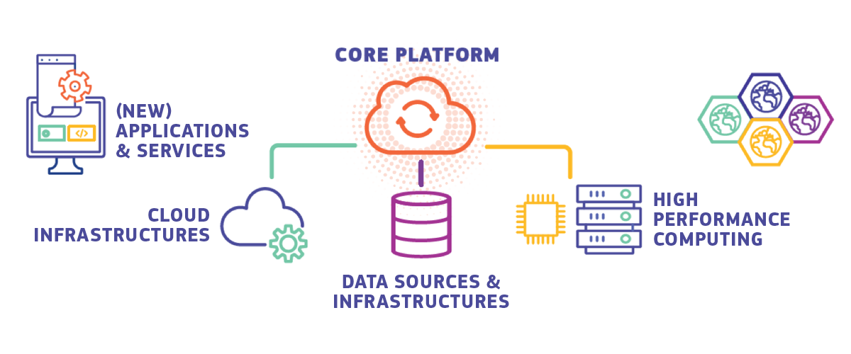
Core Service Platform (DESP)
The user access point for the DestinE ecosystem
The DESP represents an ecosystem of services providing an environment for evidence-based policy and decision-making supporting tools development and designed to be functional for a wide variety of user profiles.
Represents a framework for the analysis and management of Earth system processes with state-of-the-art applications.
Designed as an open platform easily accessible by users, Registered Services, and service providers.
Enables the development and exploitation of applications and services targeting DestinE data.
Provides users with direct access to the data and functionalities provided by the other DestinE components.

Slide 4
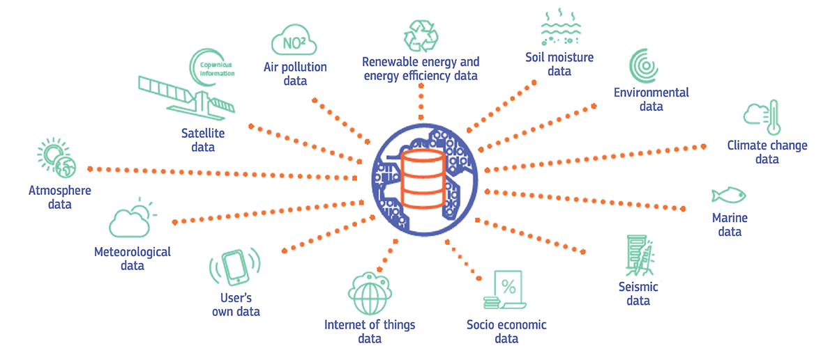
Data Lake (DEDL)
Data access and processing services
The data lake will bring together data from ESA, EUMETSAT, ECMWF as well as from Copernicus, and many other diverse sources, with new data from the Digital Twins. It will allow discovery and data access as well as big data processing in the cloud.
Built from geographically distributed physical elements that references and provides seamless access to all DestinE user required data.
Provision of data and information available from many external data spaces or generated by the DestinE Digital Twins, users' models from DEDL and applications on the DESP, regardless of data type and location.
Supports near-data processing to maximise throughput and service scalability and implements big data distributed workflows.
Will provide harmonisation of data access, beyond anything that exists today.

Slide 5
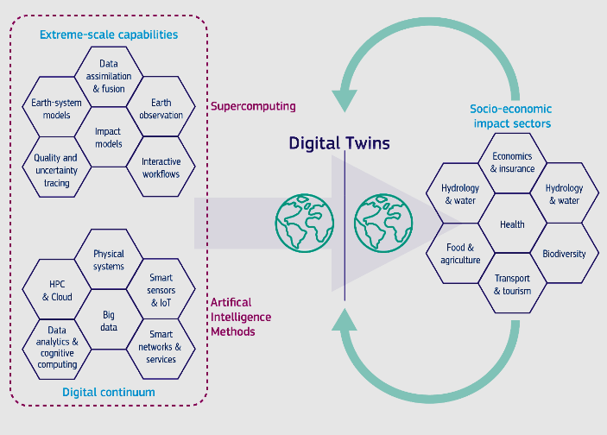
Digital Twin Engine and Digital Twins
Climate and weather simulations powered by extreme-scale computing
The DestinE Digital Twin Engine (DTE): unified orchestration of Earth-system simulations and their fusion with observations, requiring largescale HPC and data handling resources. Built from geographically distributed physical elements, providing seamless access to all DestinE data.
Weather-induced and Geophysical Extremes Digital Twin: Assessment and prediction of environmental extremes (a few days ahead)
Climate Change Adaptation Digital Twin: Supporting climate change adaptation policies and mitigation scenario testing (multidecadal)

Slide 6
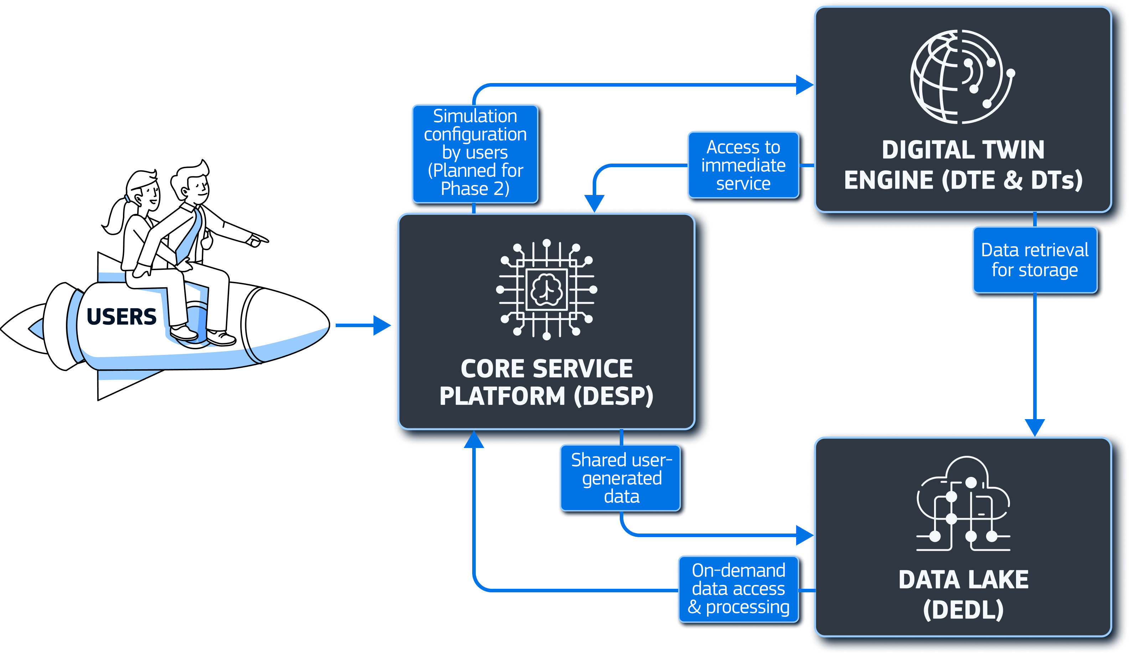
How they interact

Slide 7





Timeline
OFFICIAL LAUNCH 2022 Official launch event of the initiative following the signing of the Contribution Agreements earlier in 2021. | DEVELOPMENT By 2023 Development of the main components begins. | IMPLEMENTATION By 2024 All the components of the system (Core Service Platform, Data Lake, Digital Twin Engine, first two digital twins) have been developed. The Core Service Platform and Data Lake will be transferred into operation. Demonstration of the first two digital twins on Weather-Induced Extremes and Climate Change Adaptation and the open core platform. | ENHANCEMENT By 2026 Further enhancement of the DestinE system and integration of additional digital twins and related services. | FULL EARTH REPLICA By 2030 Several thematic digital twins of the Earth-system are developed.

Slide 8
Opportunities for involvement
Visit www.destination-earth.eu to keep up-to-date with the latest developments and join the community and receive updates on:
DestinE User eXchange: Bi-annual gathering for the DestinE community.
Webinars: Learn about specific developments and opportunities directly from the developers of DestinE.
Requirements gathering opportunities: Participate to surveys, hackathons and consultations that can influence the development direction of DestinE.
Procurements: Get directly involved in implementing DestinE components, use cases or services.

Slide 9
Thank you!

